Slide 1
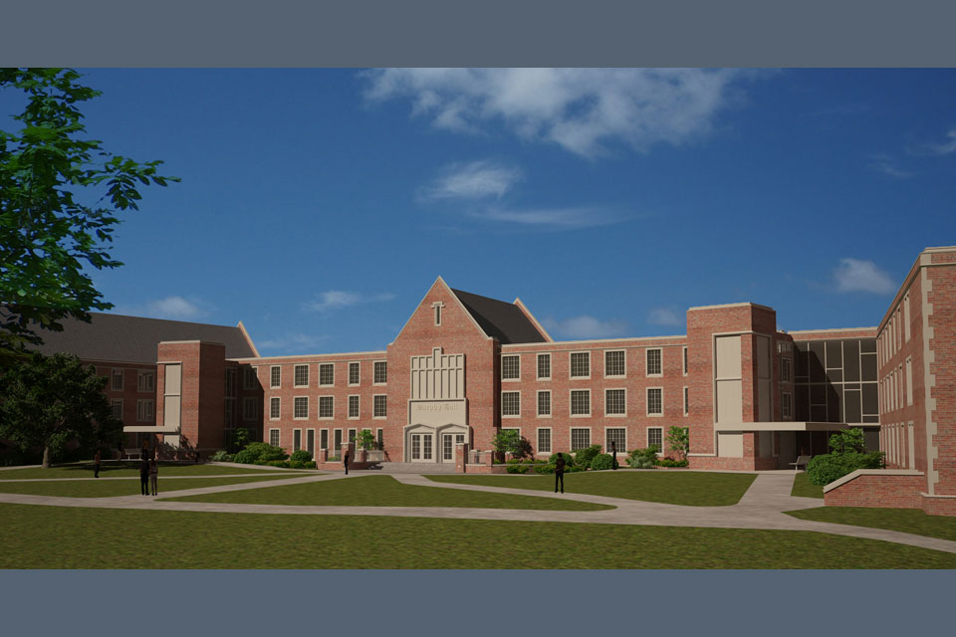
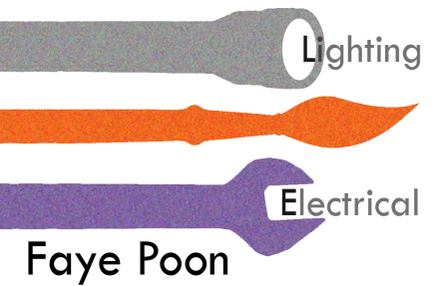
1
Thesis | Apr 14, 14
Murphy Hall
John Carroll University
Advisor: Shawn Good
Copyright by Hasenstab Architects
| Murphy Hall
| John Carroll University
| 1 John Carroll Boulevard, University Heights, OH 44118
| Faye Poon
| Lighting / Electrical
| Advisor: Shawn Good
Introduction
Lighting Design -
West Lobby and Corridor
Lighting Design - Lounge
Structural
Electrical
Summary

Slide 2
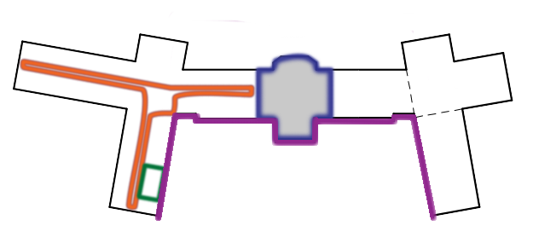
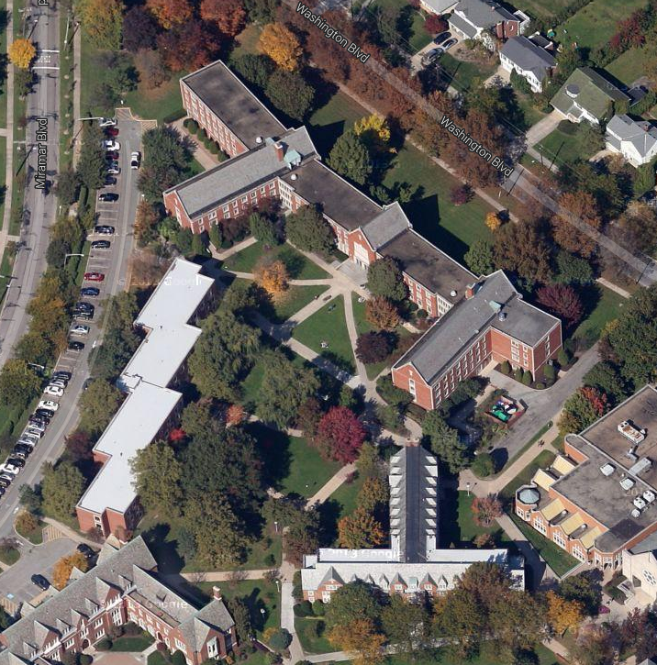

2
PROJECT OVERVIEW
Thesis | Apr 14, 14
Murphy Hall
John Carroll University
Advisor: Shawn Good
THE STATISTICS
Address
Occupancy
Size
Total levels
Sustainability
Construction
Cost
Project Delivery
1 John Carroll Boulevard,
University Heights, OH 44118
Dormitory, worship, business
89,809 SF
3 stores above grade, 4 stories total
First LEED certified building on campus
May 2013- August 2014
design fee: 1.4 million;
construction fee: 22.1 million
Design-Bid-Build
Introduction
Lighting Design -
West Lobby and Corridor
Lighting Design - Lounge
Structural
Electrical
Summary

Slide 3
3
OUTLINE
Thesis | Apr 14, 14
Murphy Hall
John Carroll University
Advisor: Shawn Good
Introduction
Lighting Design -
West Lobby and Corridor
Lighting Design - Lounge
Structural
Electrical
Summary

Slide 4
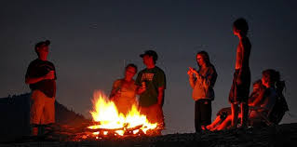

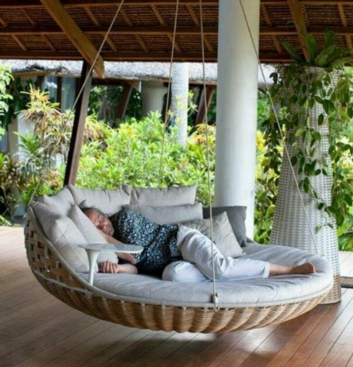
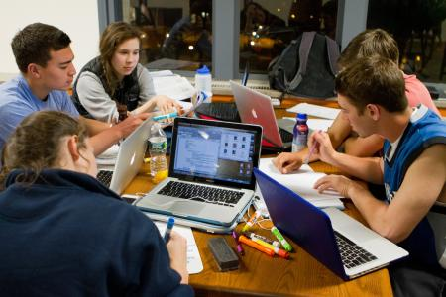
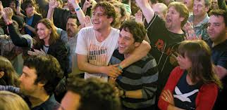
4
DESIGN CONCEPT
Thesis | Apr 14, 14
Murphy Hall
John Carroll University
Advisor: Shawn Good
RETREAT
WEST LOBBY & HALLWAY
THE LOUNGE
Introduction
Lighting Design -
West Lobby and Corridor
Lighting Design - Lounge
Structural
Electrical
Summary
SUITE LIVING
THE FACADE

Slide 5
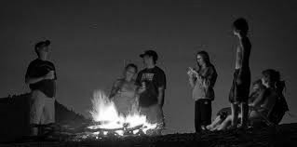

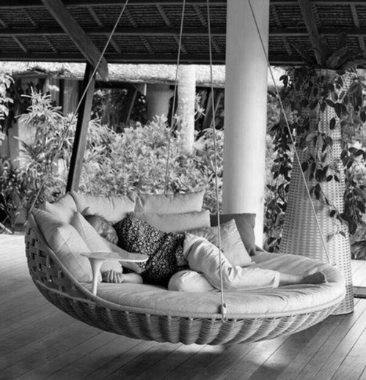
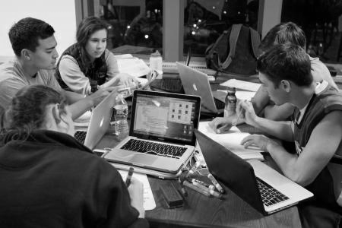
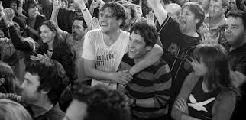
5
DESIGN CONCEPT
Thesis | Apr 14, 14
Murphy Hall
John Carroll University
Advisor: Shawn Good
RETREAT
WEST LOBBY & HALLWAY
THE LOUNGE
Introduction
Lighting Design -
West Lobby and Corridor
Lighting Design - Lounge
Structural
Electrical
Summary
SUITE LIVING
THE FACADE
STIMULATING
HOMECOMING
BONDING
RELAXING

Slide 6
6
DESIGN CONCEPT
Thesis | Apr 14, 14
Murphy Hall
John Carroll University
Advisor: Shawn Good
RETREAT
STIMULATING
RELAXING
Introduction
Lighting Design -
West Lobby and Corridor
Lighting Design - Lounge
Structural
Electrical
Summary
BONDING
HOMECOMING
STIMULATING
HOMECOMING
BONDING
RELAXING

Slide 7
7
DESIGN CONCEPT
Thesis | Apr 14, 14
Murphy Hall
John Carroll University
Advisor: Shawn Good
RETREAT
STIMULATING
RELAXING
Introduction
Lighting Design -
West Lobby and Corridor
Lighting Design - Lounge
Structural
Electrical
Summary

Slide 8
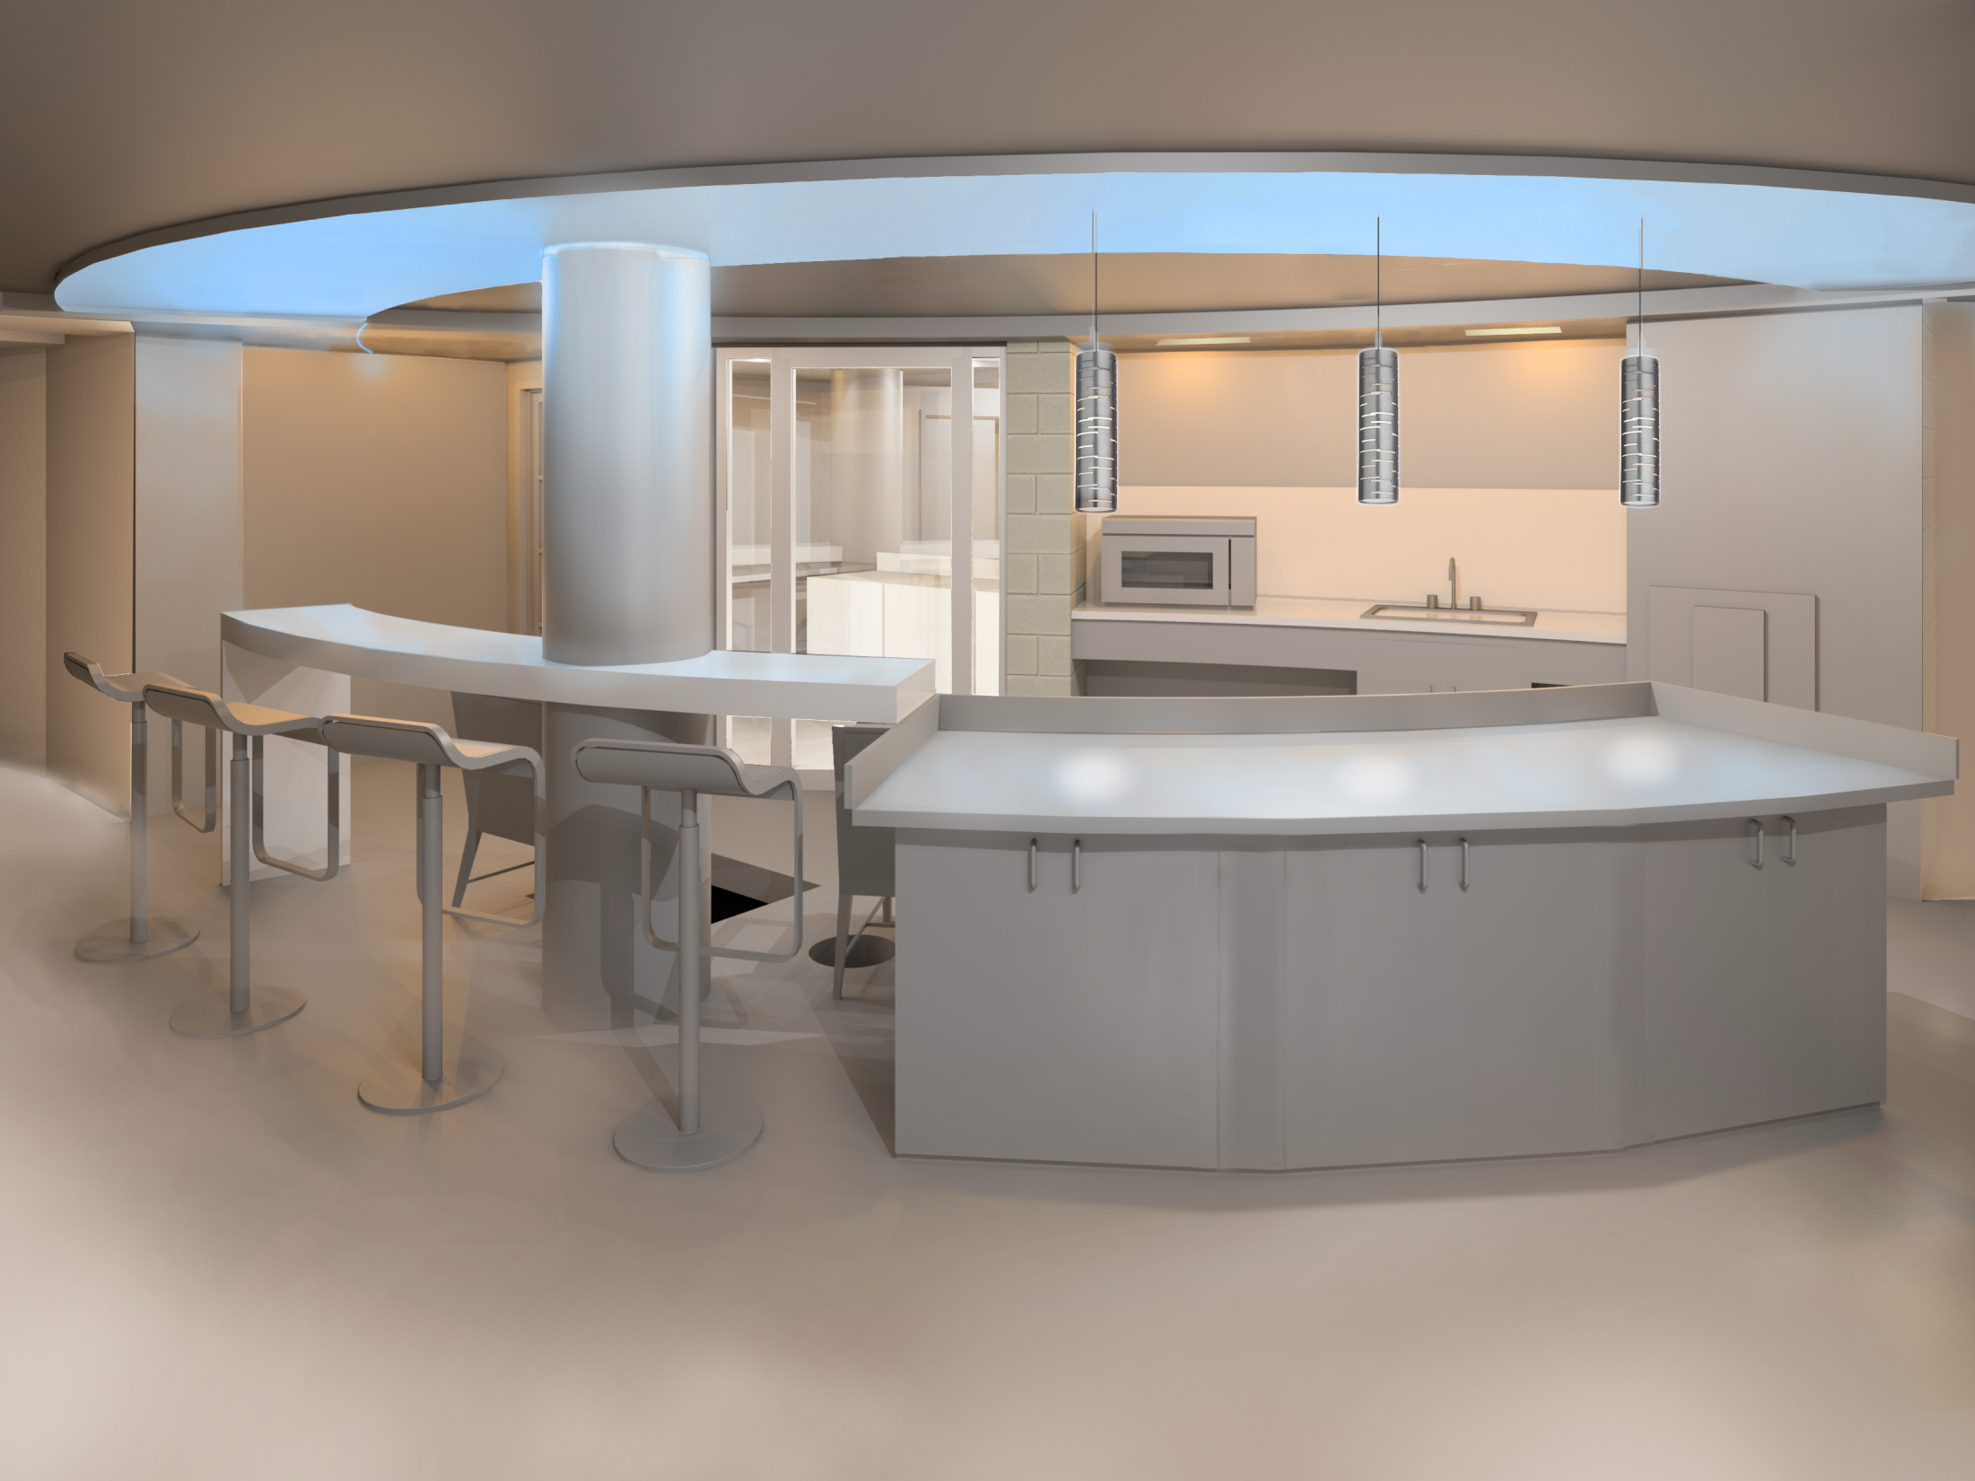
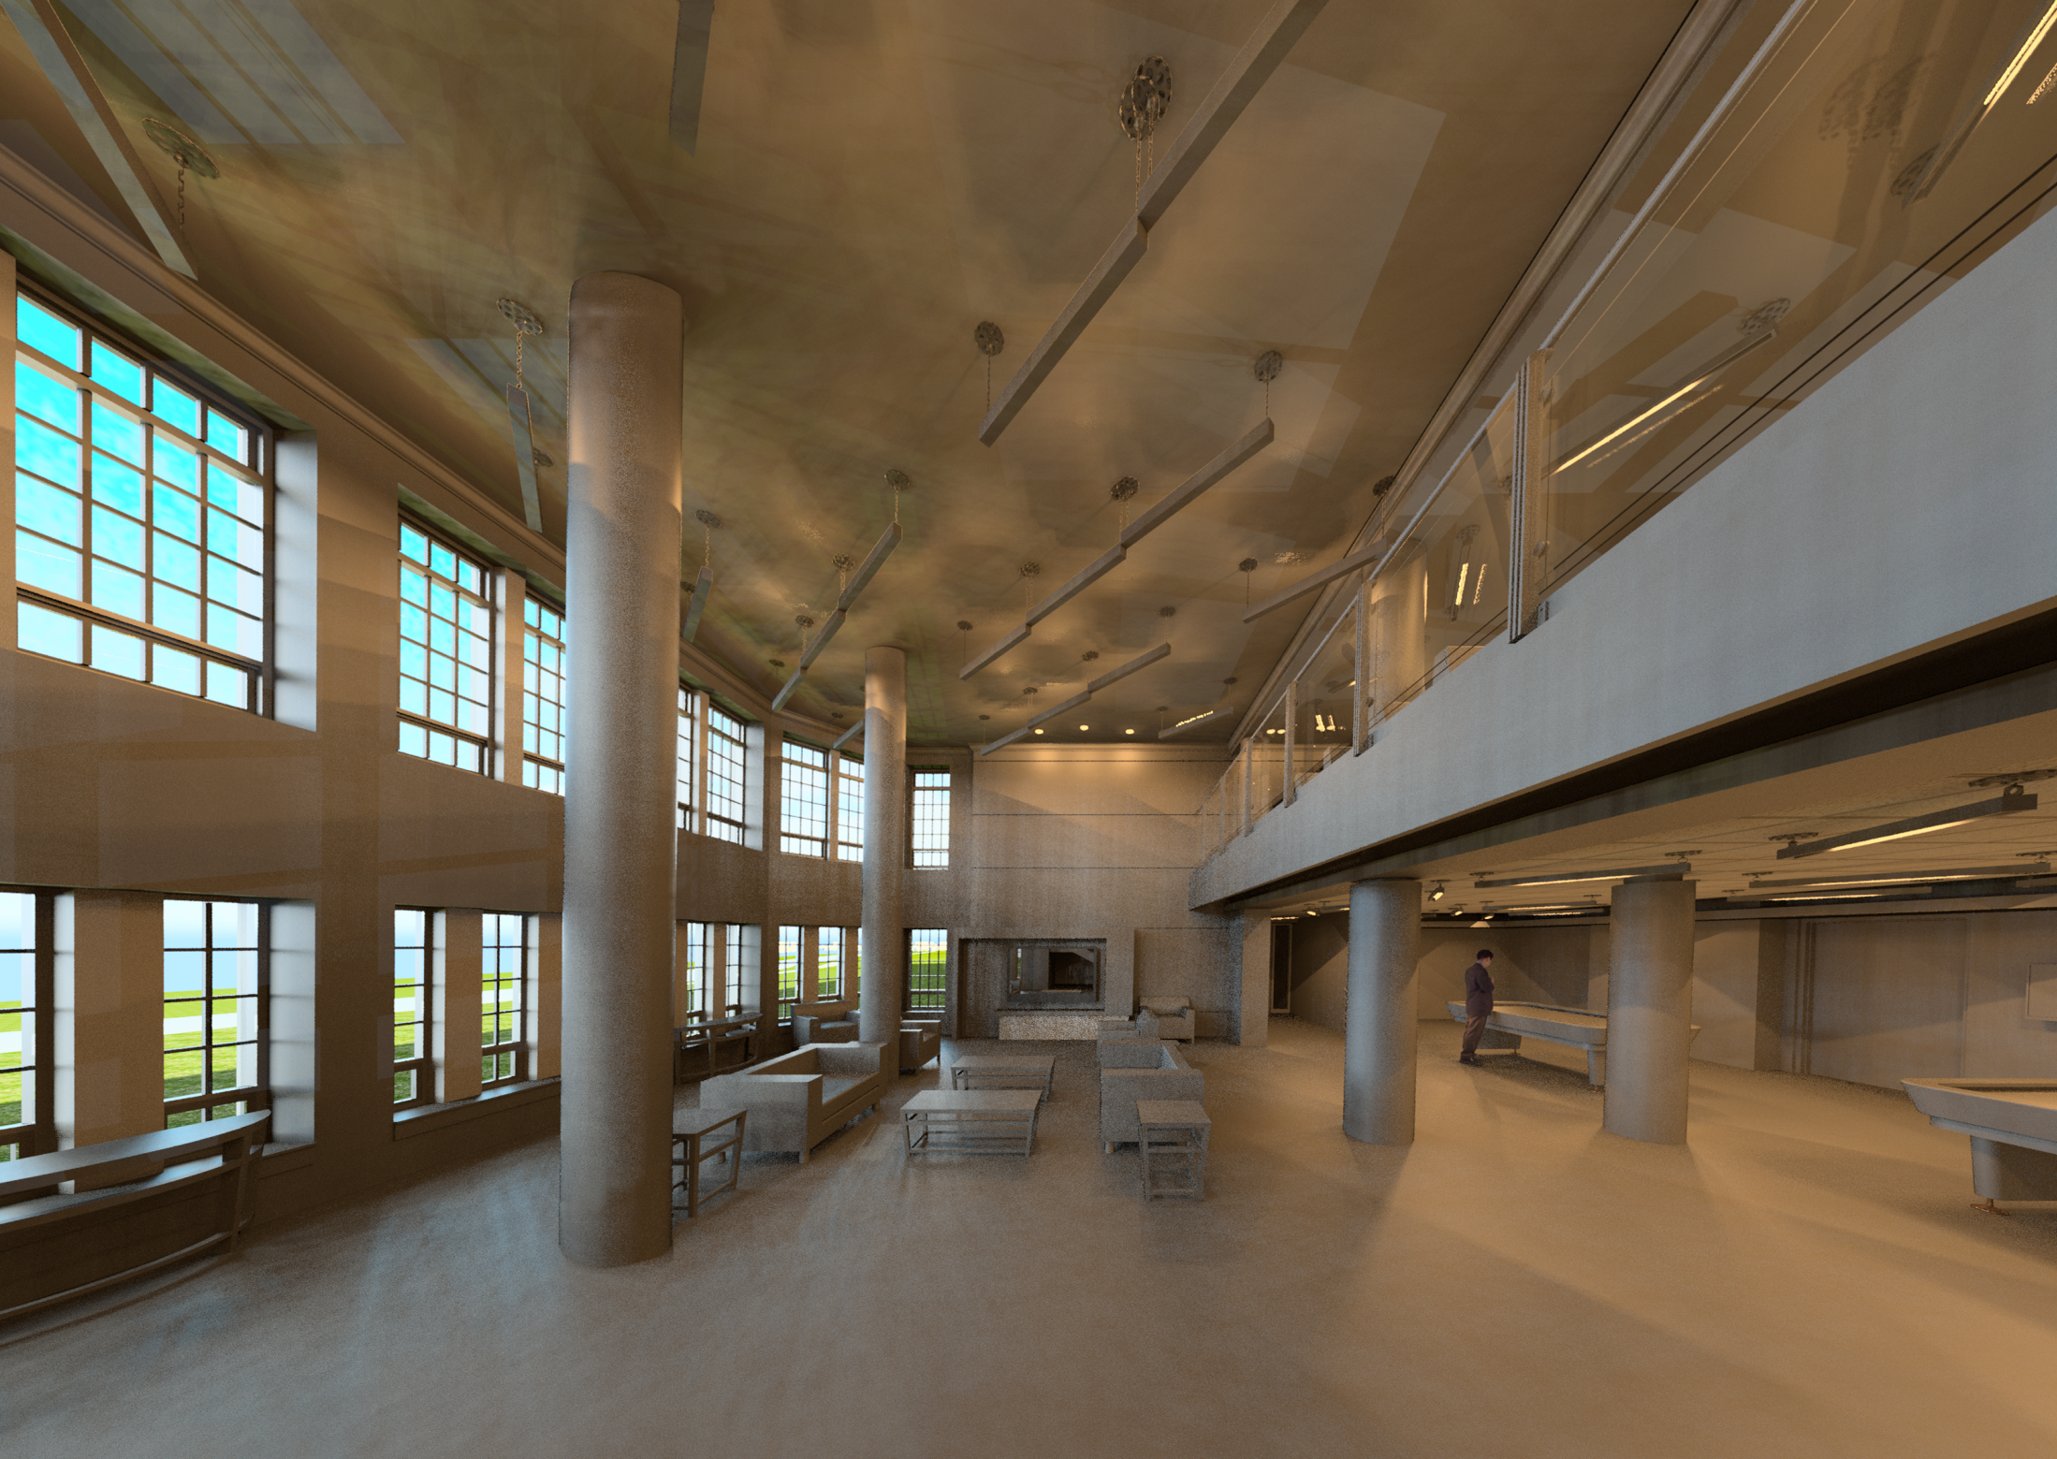
8
LIGHTING DEPTH
Thesis | Apr 14, 14
Murphy Hall
John Carroll University
Advisor: Shawn Good
LOUNGE
WEST LOBBY
Introduction
Lighting Design -
West Lobby and Corridor
Lighting Design - Lounge
Structural
Electrical
Summary
STIMULATING
RELAXING

Slide 9
9
WEST LOBBY
Murphy Hall
John Carroll University
Advisor: Shawn Good
SPACE DESCRIPTION
Area
Occupancy Type
Design Criteria
2567 SF
(1940SF ground floor, 627 SF 1st floor)
Dormitory Multipurpose.
Stimulating
Spacious
Energy Efficiency
Introduction
Lighting Design -
West Lobby and Corridor
Lighting Design - Lounge
Structural
Electrical
Summary
STIMULATING
IES Recommendation | Eh | Ev | Avg:Min | IES pg. #
Dormitory – Multipurpose (lux) | 150 | 50 | 3:1 | 24.10
Lighting Power Density | IECC Table 505.5.2
Dormitory | 1.00 W/SF

Slide 10
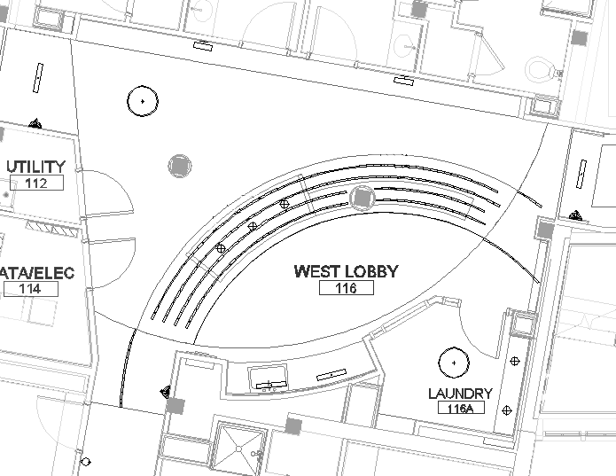
10
WEST LOBBY
Murphy Hall
John Carroll University
Advisor: Shawn Good
LIGHTING DESIGN
Introduction
Lighting Design -
West Lobby and Corridor
Lighting Design - Lounge
Structural
Electrical
Summary
STIMULATING

Slide 11
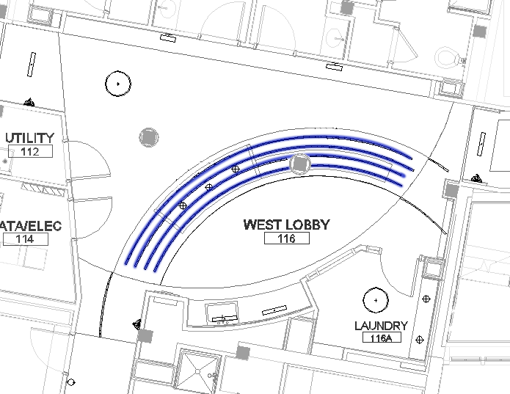
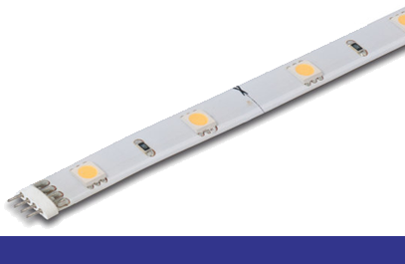
11
WEST LOBBY
Murphy Hall
John Carroll University
Advisor: Shawn Good
LIGHTING DESIGN
Introduction
Lighting Design -
West Lobby and Corridor
Lighting Design - Lounge
Structural
Electrical
Summary
STIMULATING

Slide 12
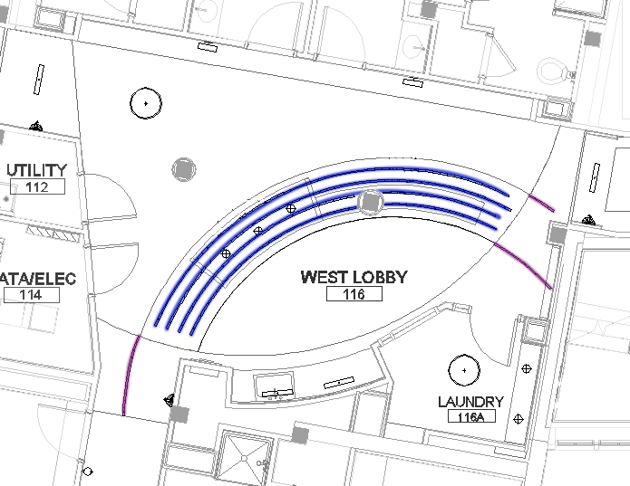
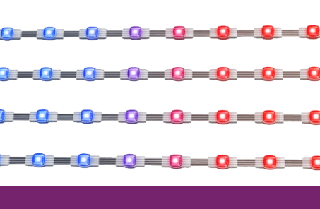
12
WEST LOBBY
Murphy Hall
John Carroll University
Advisor: Shawn Good
LIGHTING DESIGN
Introduction
Lighting Design -
West Lobby and Corridor
Lighting Design - Lounge
Structural
Electrical
Summary
STIMULATING

Slide 13
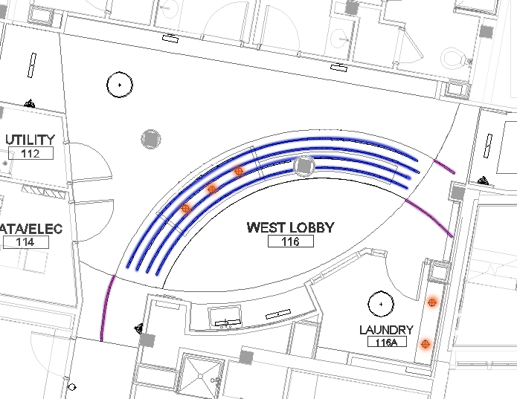
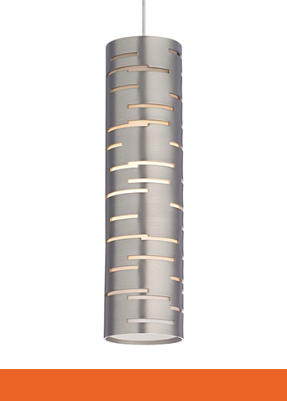
13
WEST LOBBY
Murphy Hall
John Carroll University
Advisor: Shawn Good
LIGHTING DESIGN
Introduction
Lighting Design -
West Lobby and Corridor
Lighting Design - Lounge
Structural
Electrical
Summary
STIMULATING

Slide 14
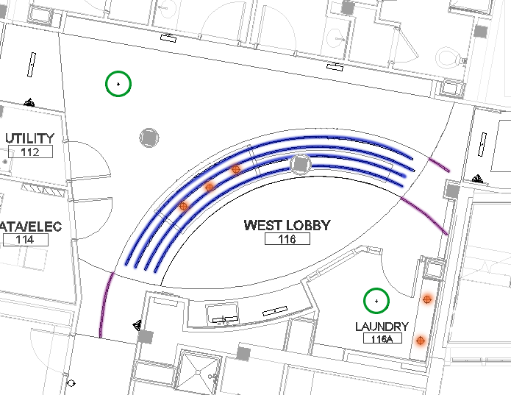
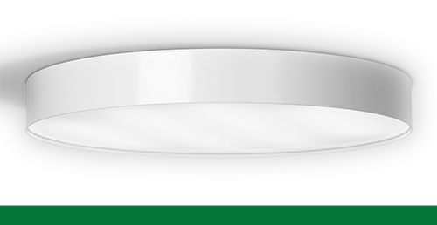
14
WEST LOBBY
Murphy Hall
John Carroll University
Advisor: Shawn Good
LIGHTING DESIGN
Introduction
Lighting Design -
West Lobby and Corridor
Lighting Design - Lounge
Structural
Electrical
Summary
STIMULATING

Slide 15
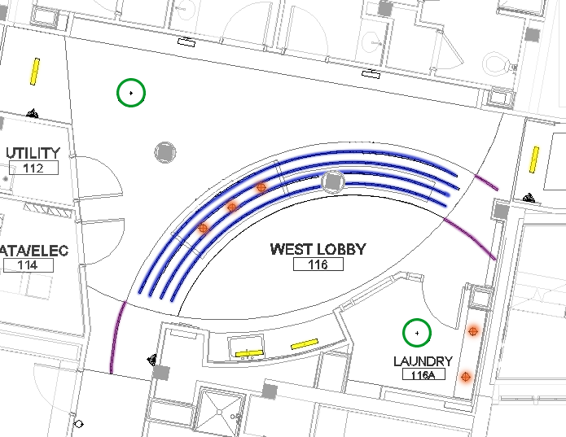
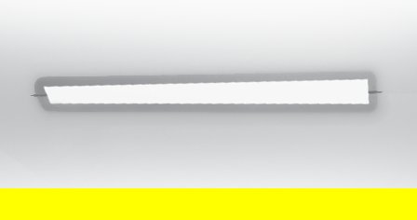
15
WEST LOBBY
Murphy Hall
John Carroll University
Advisor: Shawn Good
LIGHTING DESIGN
Introduction
Lighting Design -
West Lobby and Corridor
Lighting Design - Lounge
Structural
Electrical
Summary
STIMULATING

Slide 16

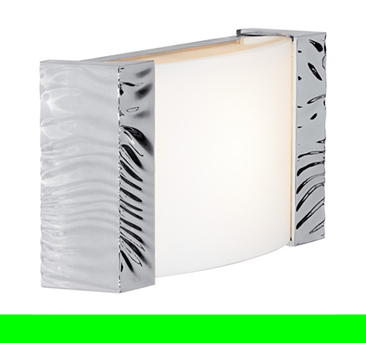
16
WEST LOBBY
Murphy Hall
John Carroll University
Advisor: Shawn Good
LIGHTING DESIGN
Introduction
Lighting Design -
West Lobby and Corridor
Lighting Design - Lounge
Structural
Electrical
Summary
STIMULATING

Slide 17
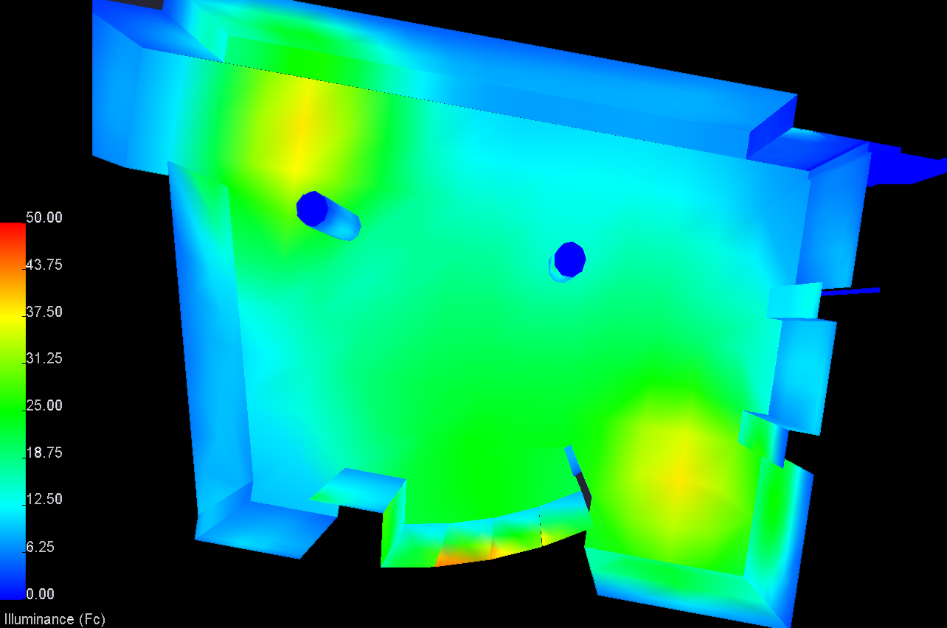
17
WEST LOBBY
Murphy Hall
John Carroll University
Advisor: Shawn Good
Introduction
Lighting Design -
West Lobby and Corridor
Lighting Design - Lounge
Structural
Electrical
Summary
STIMULATING
Average:
Floor: 22 Fc
Table: 28 Fc

Slide 18
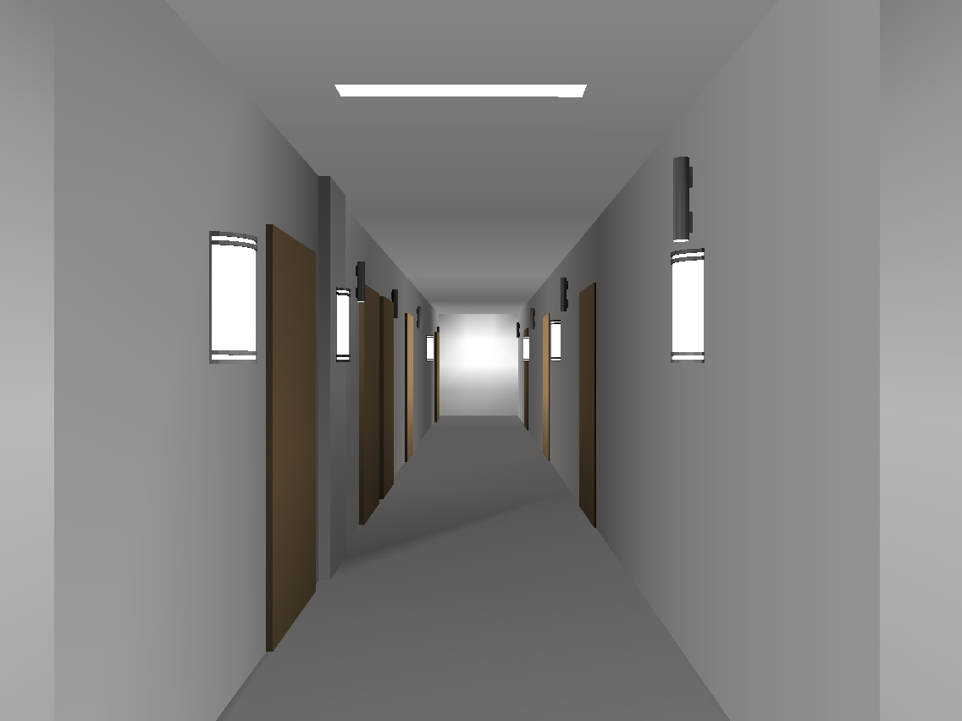
18
CORRIDORS
Murphy Hall
John Carroll University
Advisor: Shawn Good
LIGHTING DESIGN
Area
Occupancy Type
Design Criteria
1432 SF
Dormitory Circulation
Stimulating
Spacious
Energy Efficiency
Introduction
Lighting Design -
West Lobby and Corridor
Lighting Design - Lounge
Structural
Electrical
Summary
STIMULATING
IES Recommendation | Eh | Ev | Avg:Min | IES pg. #
Transition – Independent Passage Ways (lux) | 25 | 15 | 2:1 | 24.18
Lighting Power Density | IECC Table 505.5.2
Dormitory | 1.00 W/SF

Slide 19
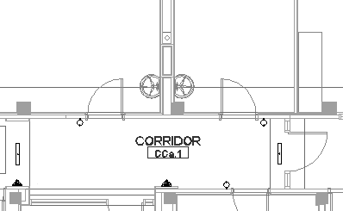
19
CORRIDORS
Murphy Hall
John Carroll University
Advisor: Shawn Good
LIGHTING DESIGN
Introduction
Lighting Design -
West Lobby and Corridor
Lighting Design - Lounge
Structural
Electrical
Summary
STIMULATING

Slide 20
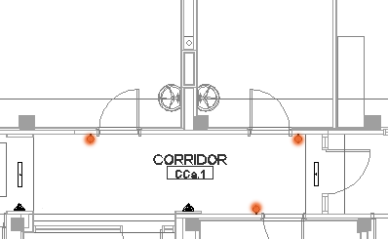
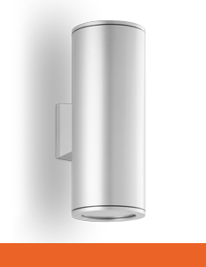
20
CORRIDORS
Murphy Hall
John Carroll University
Advisor: Shawn Good
LIGHTING DESIGN
Introduction
Lighting Design -
West Lobby and Corridor
Lighting Design - Lounge
Structural
Electrical
Summary
STIMULATING

Slide 21
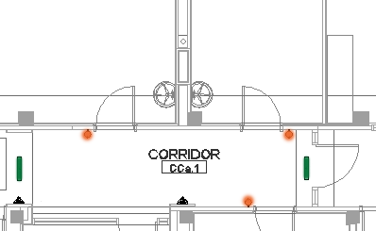

21
CORRIDORS
Murphy Hall
John Carroll University
Advisor: Shawn Good
LIGHTING DESIGN
Introduction
Lighting Design -
West Lobby and Corridor
Lighting Design - Lounge
Structural
Electrical
Summary
STIMULATING

Slide 22
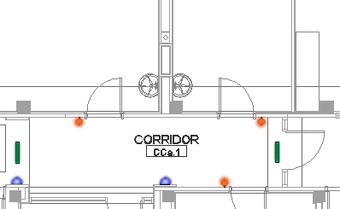
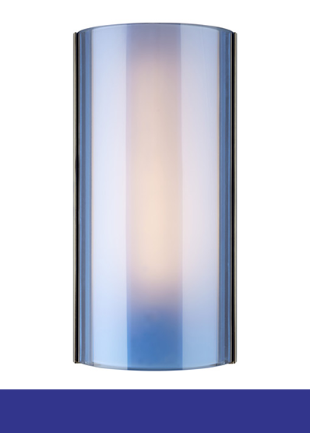
22
CORRIDORS
Murphy Hall
John Carroll University
Advisor: Shawn Good
LIGHTING DESIGN
Introduction
Lighting Design -
West Lobby and Corridor
Lighting Design - Lounge
Structural
Electrical
Summary
STIMULATING

Slide 23
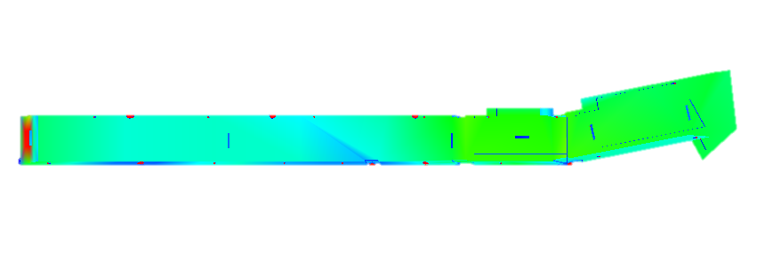
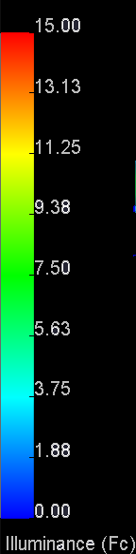
23
CORRIDORS
Murphy Hall
John Carroll University
Advisor: Shawn Good
Introduction
Lighting Design -
West Lobby and Corridor
Lighting Design - Lounge
Structural
Electrical
Summary
STIMULATING
Average:
Floor: 5 Fc

Slide 24
24
LOUNGE
Thesis | Apr 14, 14
Murphy Hall
John Carroll University
Advisor: Shawn Good
SPACE DESCRIPTION
Place holder for Lounge thumbnail
Area
Occupancy Type
Design Criteria
1432 SF
(1940SF ground floor, 627 SF 1st floor)
Dormitory Multipurpose.
Uniformity
Illuminance
Accent Lighting
Introduction
Lighting Design -
West Lobby and Corridor
Lighting Design - Lounge
Structural
Electrical
Summary
RELAXING
IES Recommendation | Eh | Ev | Avg:Min | IES pg. #
Dormitory – Multipurpose (lux) | 150 | 50 | 3:1 | 24.10
Lighting Power Density | IECC Table 505.5.2
Dormitory | 1.00 W/SF

Slide 25
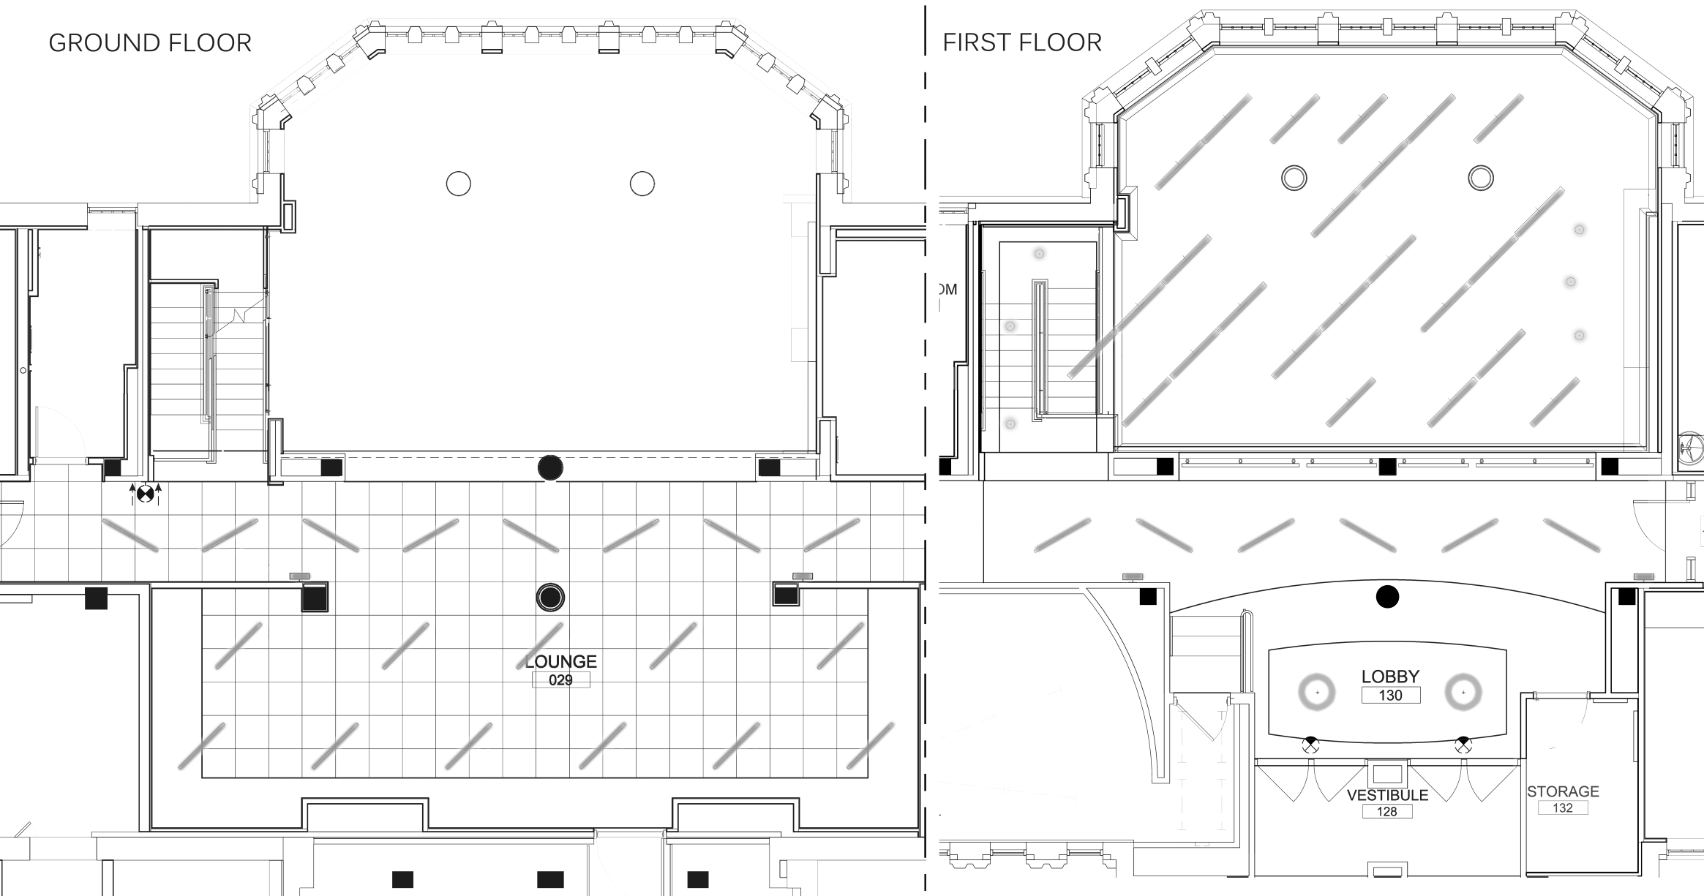
25
LOUNGE
GROUND FLOOR
1ST FLOOR
Murphy Hall
John Carroll University
Advisor: Shawn Good
LIGHTING DESIGN
Introduction
Lighting Design -
West Lobby and Corridor
Lighting Design - Lounge
Structural
Electrical
Summary
RELAXING

Slide 26
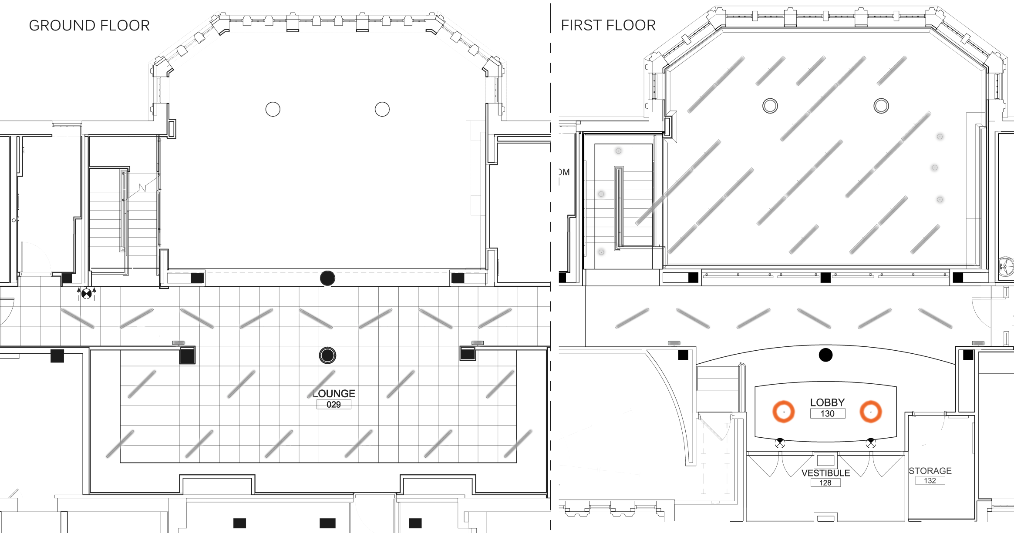
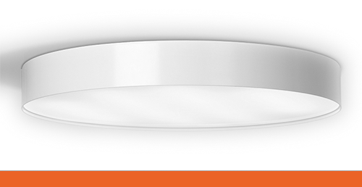
26
LOUNGE
GROUND FLOOR
1ST FLOOR
Murphy Hall
John Carroll University
Advisor: Shawn Good
LIGHTING DESIGN
Introduction
Lighting Design - Lounge
Lighting Design -
West Lobby and Corridor
Structural
Electrical
Summary
RELAXING

Slide 27
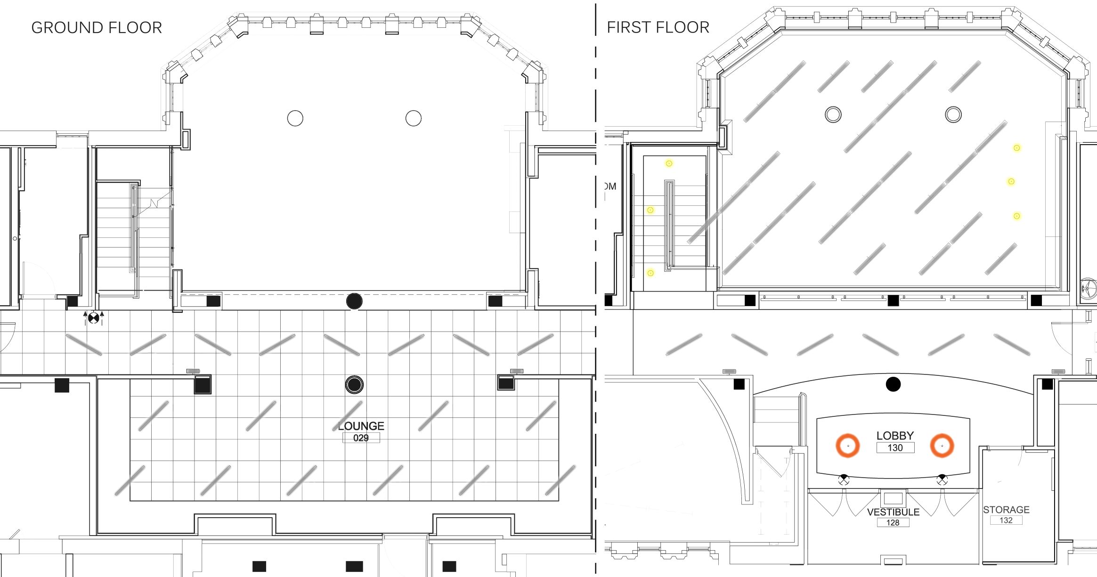
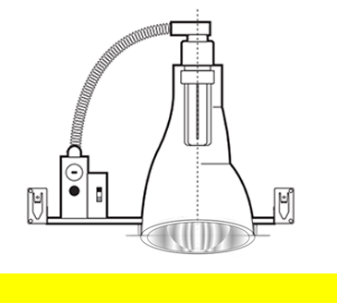
27
LOUNGE
GROUND FLOOR
1ST FLOOR
Murphy Hall
John Carroll University
Advisor: Shawn Good
LIGHTING DESIGN
Introduction
Lighting Design -
West Lobby and Corridor
Lighting Design - Lounge
Structural
Electrical
Summary
RELAXING

Slide 28


28
LOUNGE
GROUND FLOOR
1ST FLOOR
Murphy Hall
John Carroll University
Advisor: Shawn Good
LIGHTING DESIGN
Introduction
Lighting Design -
West Lobby and Corridor
Lighting Design - Lounge
Structural
Electrical
Summary
RELAXING

Slide 29
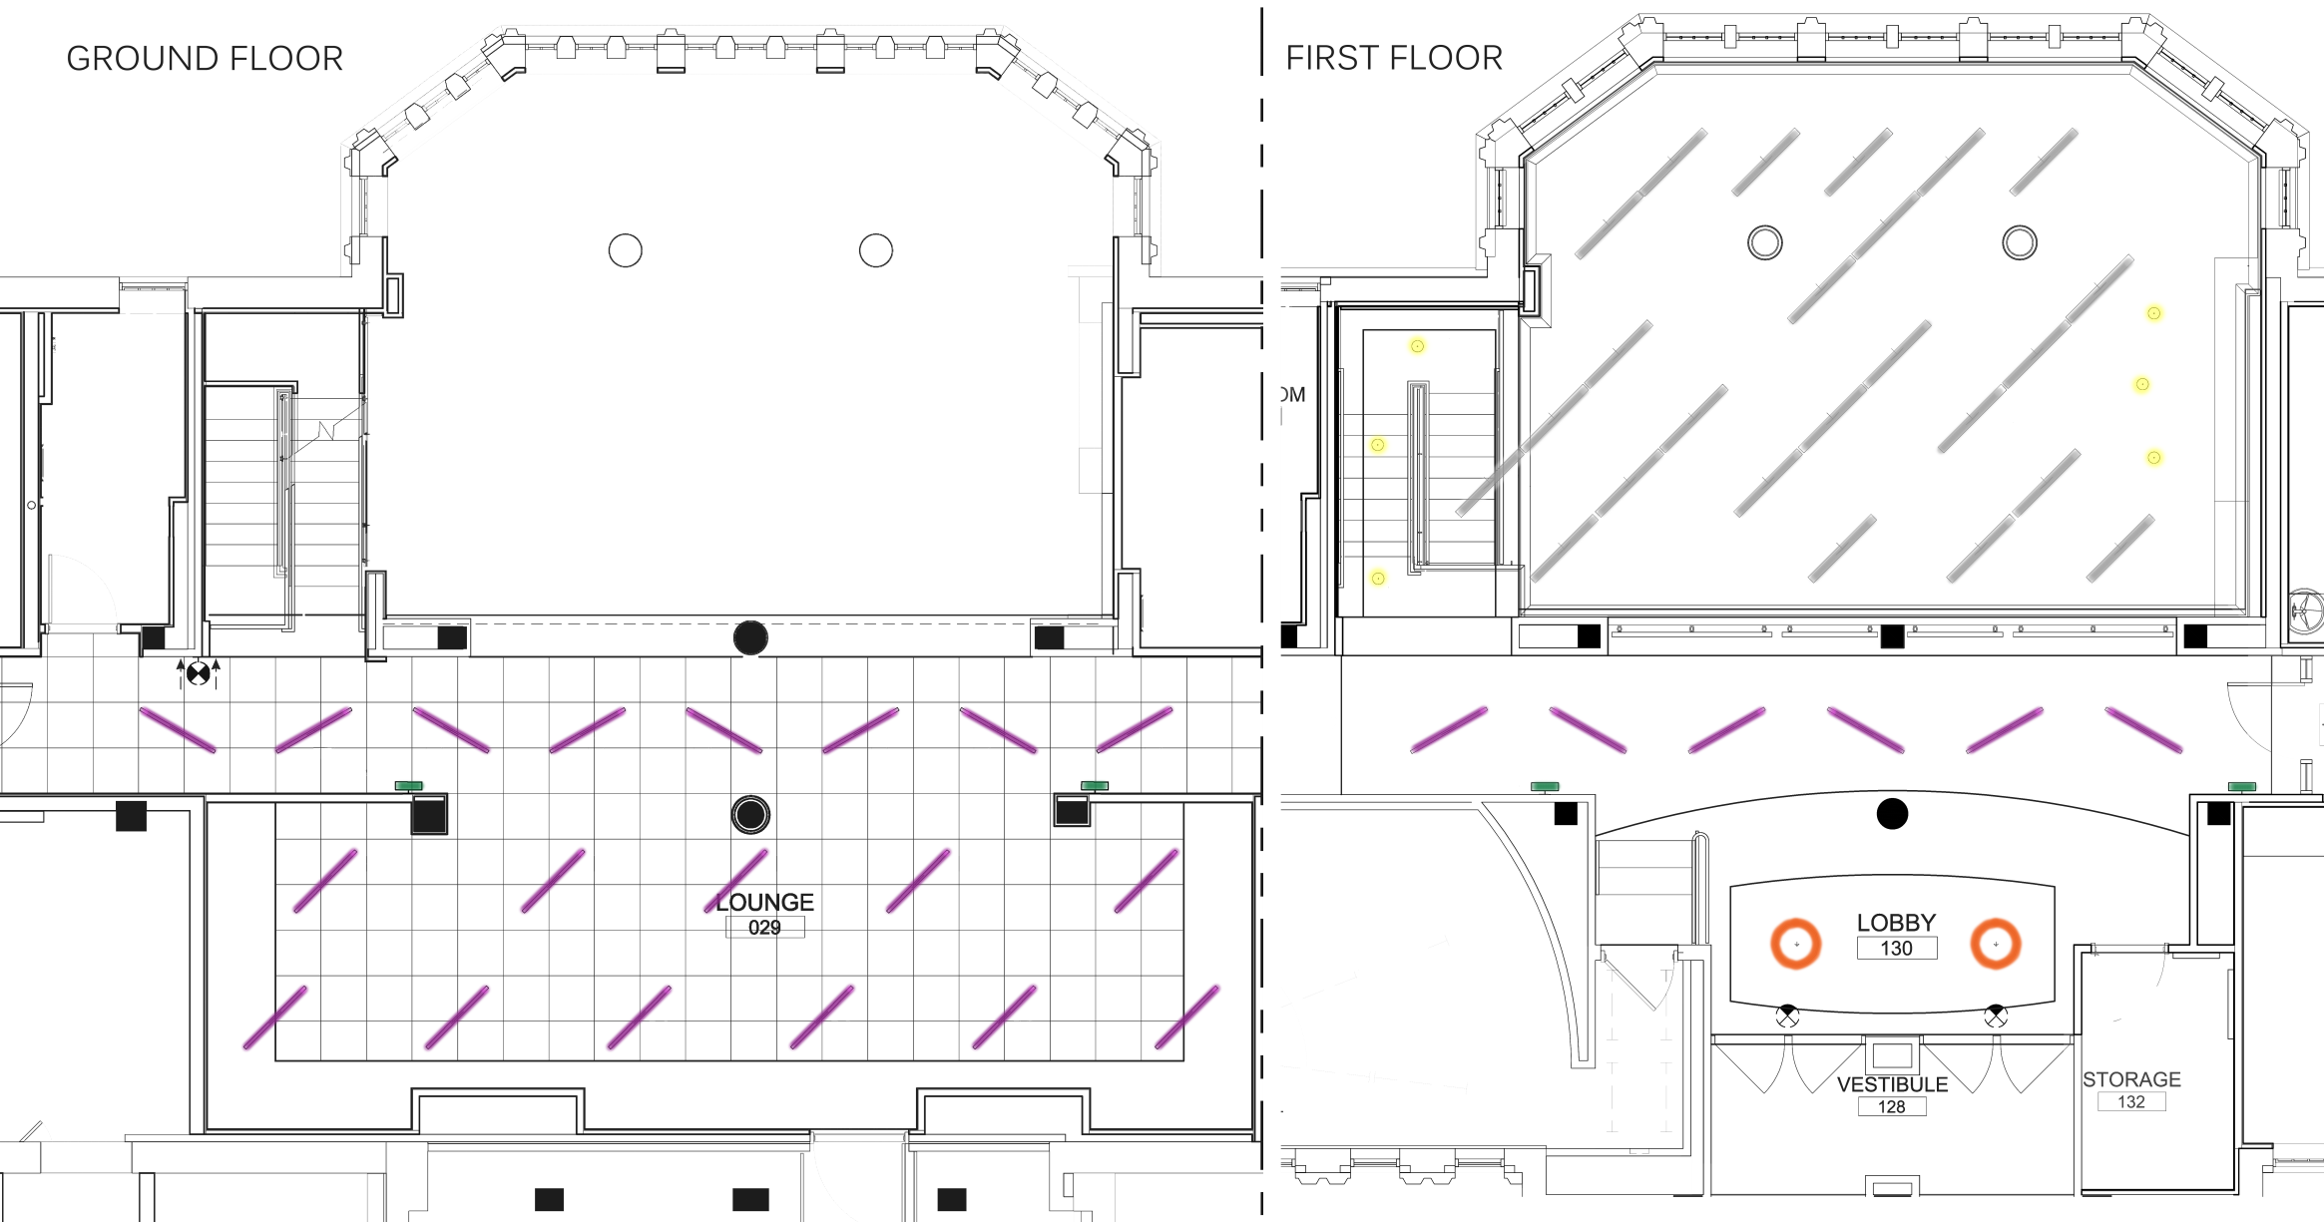
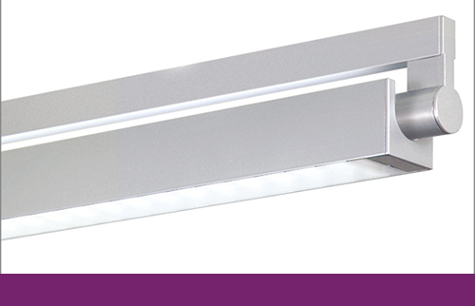
29
LOUNGE
GROUND FLOOR
1ST FLOOR
Murphy Hall
John Carroll University
Advisor: Shawn Good
LIGHTING DESIGN
Introduction
Lighting Design -
West Lobby and Corridor
Lighting Design - Lounge
Structural
Electrical
Summary
RELAXING

Slide 30
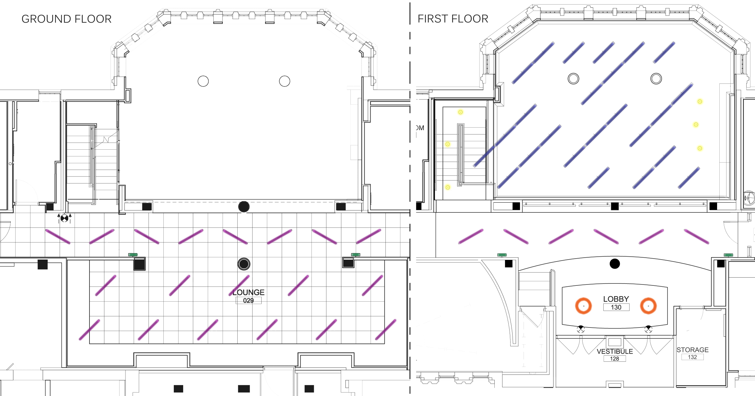
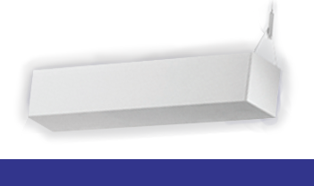
30
LOUNGE
GROUND FLOOR
1ST FLOOR
Murphy Hall
John Carroll University
Advisor: Shawn Good
LIGHTING DESIGN
Introduction
Lighting Design -
West Lobby and Corridor
Lighting Design - Lounge
Structural
Electrical
Summary
RELAXING

Slide 31
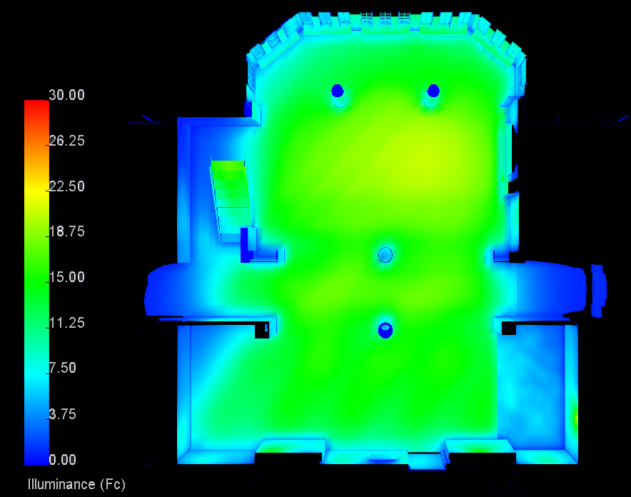
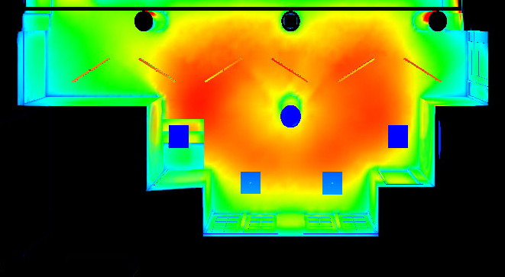
31
LOUNGE
Murphy Hall
John Carroll University
Advisor: Shawn Good
Introduction
Lighting Design -
West Lobby and Corridor
Lighting Design - Lounge
Structural
Electrical
Summary
RELAXING
Average:
Lobby: 25 Fc
Stair: 20 Fc

Slide 32
32
LOUNGE
Murphy Hall
John Carroll University
Advisor: Shawn Good
Introduction
Lighting Design -
West Lobby and Corridor
Lighting Design - Lounge
Structural
Electrical
Summary
RELAXING
LPD:
0.81 W/SF
Average:
Open Plan: 14 Fc

Slide 33
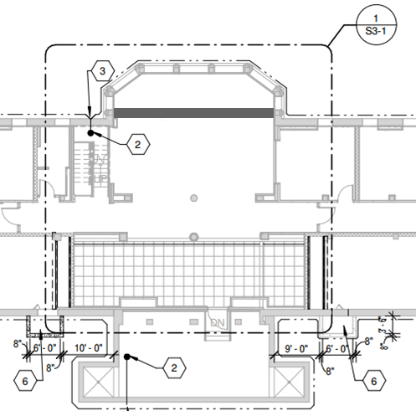
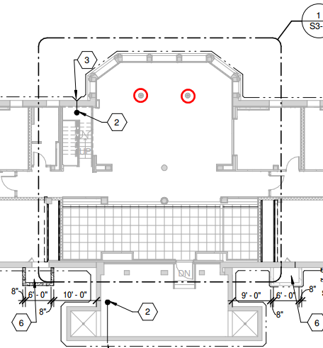
33
LOUNGE
Murphy Hall
John Carroll University
Advisor: Shawn Good
STRUCTURAL BREADTH
Introduction
Lighting Design -
West Lobby and Corridor
Lighting Design - Lounge
Structural
Electrical
Summary

Slide 34
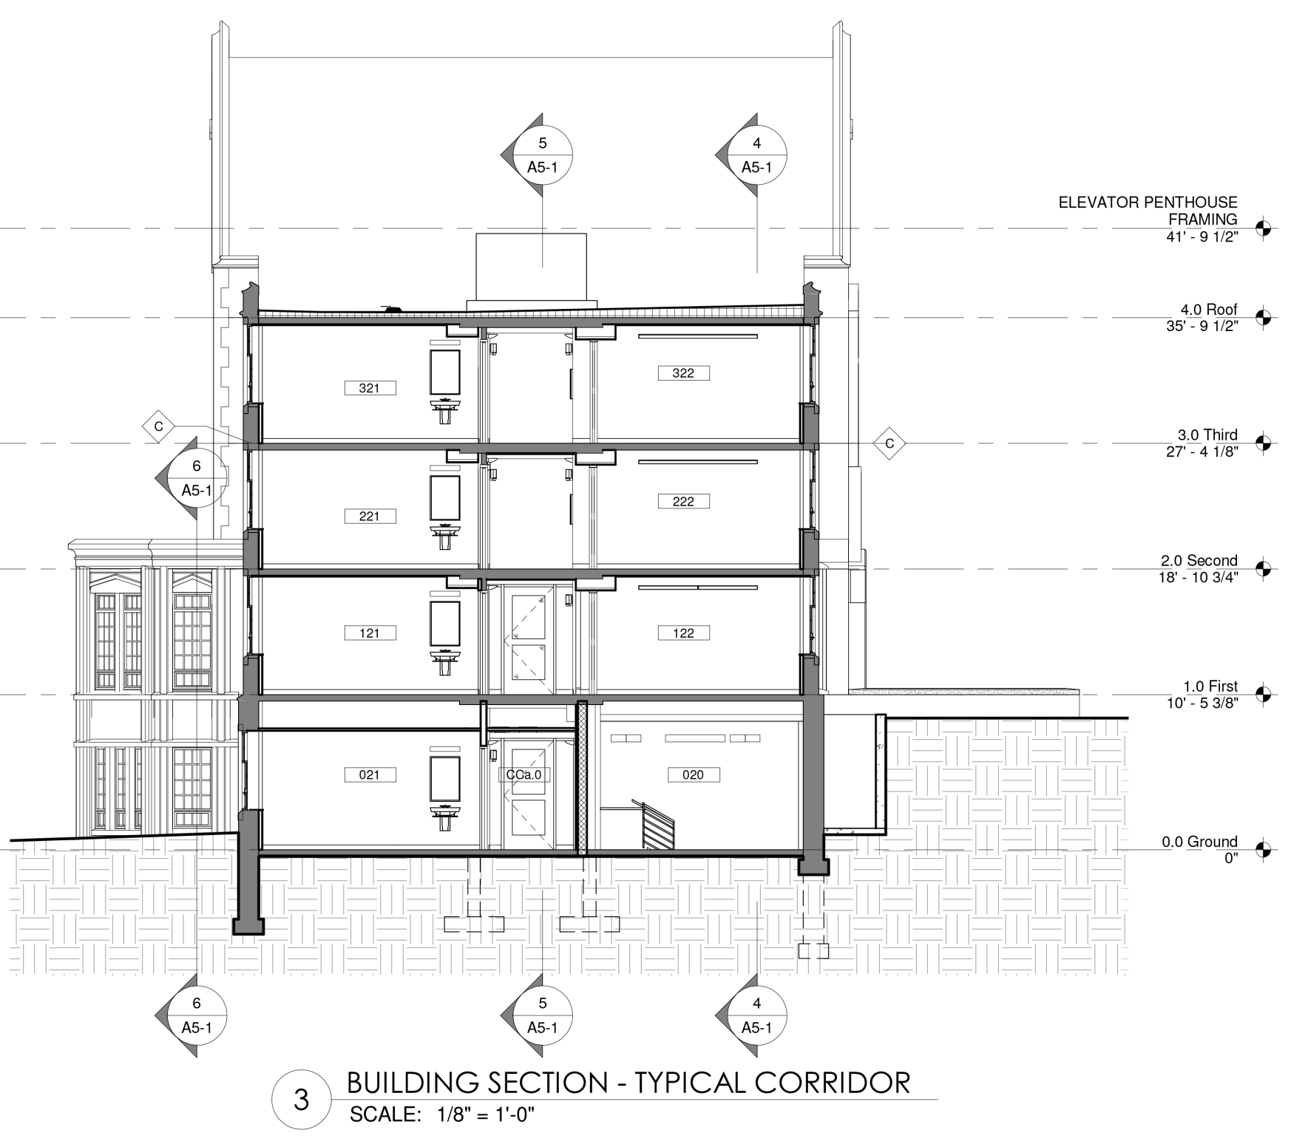
34
LOUNGE
Thesis | Apr 14, 14
Murphy Hall
John Carroll University
Advisor: Shawn Good
STRUCTURAL BREADTH
Type | Factors | Load | Distribute length | # Floor | Load LF
Attic | Live Load Dead Load | 40 PSF 75 PSF | 8.5 ft | 1 | 340 lb/LF 638 lb/LF
Floor | Live load Dead load | 40 PSF 80 PSF | 8.5 ft | 2 | 680 lb/LF 1360 lb/LF
Exterior Wall | Dead load | 107 PSF | 8.45 ft tall | 2.5 | 2261 lb/LF
Flat Roof | Live load Dead load Snow load | 30 PSF 80 PSF 29 PSF | 7.84 ft | 1 | 235 lb/LF 627 lb/LF 228 lb/LF
Introduction
Lighting Design -
West Lobby and Corridor
Lighting Design - Lounge
Structural
Electrical
Summary

Slide 35

35
LOUNGE
22”
Murphy Hall
John Carroll University
Advisor: Shawn Good
STRUCTURAL BREADTH
Type | Factors | Load | Distribute length | # Floor | Load LF
Attic | Live Load Dead Load | 40 PSF 75 PSF | 8.5 ft | 1 | 340 lb/LF 638 lb/LF
Floor | Live load Dead load | 40 PSF 80 PSF | 8.5 ft | 2 | 680 lb/LF 1360 lb/LF
Exterior Wall | Dead load | 107 PSF | 8.45 ft tall | 2.5 | 2261 lb/LF
Flat Roof | Live load Dead load Snow load | 30 PSF 80 PSF 29 PSF | 7.84 ft | 1 | 235 lb/LF 627 lb/LF 228 lb/LF
36”
33”
#3 @ 8” o.c.
Introduction
Lighting Design -
West Lobby and Corridor
Lighting Design - Lounge
Structural
Electrical
Summary
(8) #9 @ 2.7” o.c.

Slide 36




36
ELECTRICAL DEPTH
Murphy Hall
John Carroll University
Advisor: Shawn Good
PHOTOVOLTAIC SYSTEM
Metric | Base
Cost of System | $457,108.18
Annual Energy | 71,717 | kW/h
System performance factor (%) | 84 | %
Total Land Area | 0.31 | Acres
Payback (years) | 1.32 | Years
Introduction
Lighting Design -
West Lobby and Corridor
Lighting Design - Lounge
Structural
Electrical
Summary

Slide 37

37
ELECTRICAL DEPTH
Murphy Hall
John Carroll University
Advisor: Shawn Good
PHOTOVOLTAIC SYSTEM
Annual Energy Delivered
85,390.5
kWh
82060.7
78417.0
72441.3
71716.9
71716.9
Introduction
Lighting Design -
West Lobby and Corridor
Lighting Design - Lounge
Structural
Electrical
Summary

Slide 38
38
SUMMARY
Murphy Hall
John Carroll University
Advisor: Shawn Good
Dormitory
Lighting Concept of Retreat
Stimulating theme for West lobby and Corridor
Relaxing theme for lounge
Transfer girder as alternative to columns in lounge
PV system produce 71.7MWh annual energy
Introduction
Lighting Design -
West Lobby and Corridor
Lighting Design - Lounge
Structural
Electrical
Summary

Slide 39


39
SUMMARY
Murphy Hall
John Carroll University
Advisor: Shawn Good
Dormitory
Lighting Concept of Retreat
Stimulating theme for West lobby and Corridor
Relaxing theme for lounge
Transfer girder as alternative to columns in lounge
PV system produce 71.7MWh annual energy
Introduction
Lighting Design -
West Lobby and Corridor
Lighting Design - Lounge
Structural
Electrical
Summary

Slide 40
40
SUMMARY
Murphy Hall
John Carroll University
Advisor: Shawn Good
Dormitory
Lighting Concept of Retreat
Stimulating theme for West lobby and Corridor
Relaxing theme for lounge
Transfer girder as alternative to columns in lounge
PV system produce 71.7MWh annual energy
Introduction
Lighting Design -
West Lobby and Corridor
Lighting Design - Lounge
Structural
Electrical
Summary

Slide 41
41
SUMMARY
Murphy Hall
John Carroll University
Advisor: Shawn Good
Dormitory
Lighting Concept of Retreat
Stimulating theme for West lobby and Corridor
Relaxing theme for lounge
Transfer girder as alternative to columns in lounge
PV system produce 71.7MWh annual energy
Introduction
Lighting Design -
West Lobby and Corridor
Lighting Design - Lounge
Structural
Electrical
Summary

Slide 42
42
ACKNOWLEDGEMENT
Murphy Hall
John Carroll University
Advisor: Shawn Good
Carol P. Dietz Associate VP of Facilities, John Carroll University
Christian Todd Principal, McHenry and Associates
Kelly Hersh Engineer, McHenry and Associates
Dr. Mistrick AE faculty
Dr. Houser AE faculty
Shawn Good Lighting Department Head, Brinjac Engineering
Leslie Beahm Electrical Advisor, Reese Engineering
Family and friends for their support
Introduction
Lighting Design -
West Lobby and Corridor
Lighting Design - Lounge
Structural
Electrical
Summary

Slide 43
43
SUMMARY
Murphy Hall
John Carroll University
Advisor: Shawn Good
QUESTIONS?
Introduction
Lighting Design -
West Lobby and Corridor
Lighting Design - Lounge
Structural
Electrical
Summary

Slide 44



44
APPENDIX
Thesis | Apr 14, 14
Murphy Hall
John Carroll University
Advisor: Shawn Good
PHOTOVOLTAIC SYSTEM
Dormitory, worship, business
89,809 SF
3 stores above grade, 4 stories total
First LEED certified building on campus
May 2013- August 2014
design fee: 1.4 million;
construction fee: 22.1 million
Design-Bid-Build

Slide 45




45
LOUNGE
Thesis | Apr 14, 14
Murphy Hall
John Carroll University
Advisor: Shawn Good
HVAC BREADTH
Outline

